Slide 1



1st International and 7th National Conference on Multidisciplinary Design, Analysis and Optimization (iNCMDAO 2024)
December 16-18, 2024, IISc-Bengaluru
Title: Polymer Matrix Sand Composites for Enhanced Ballistic Impact Resistance
Presented By: Manas Kishor Thakur
Contributors : Manas Kishor Thakur , Nishika Nakka, Bommiditha Jyothsnavi ,Sai Sahasra Surkanti, Shiva Bansal, Rajendra Kumar Munian, Srikant Sekhar Padhee
Department of Mechanical Engineering
Indian Institute of Technology, Ropar

Slide 2
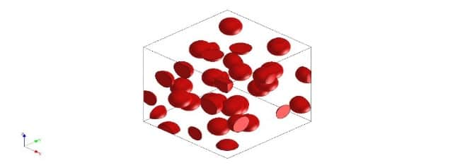
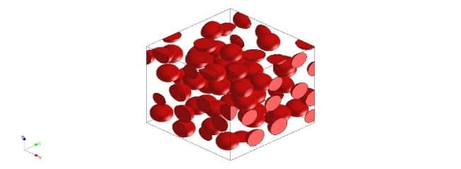
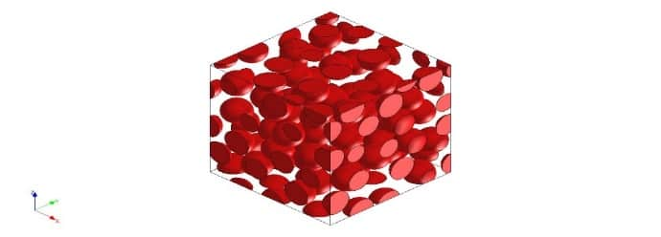
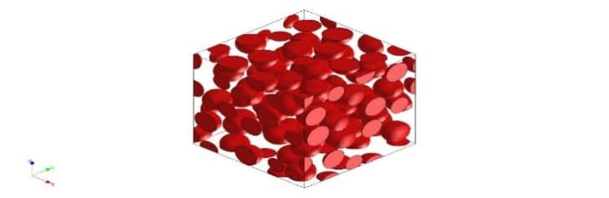
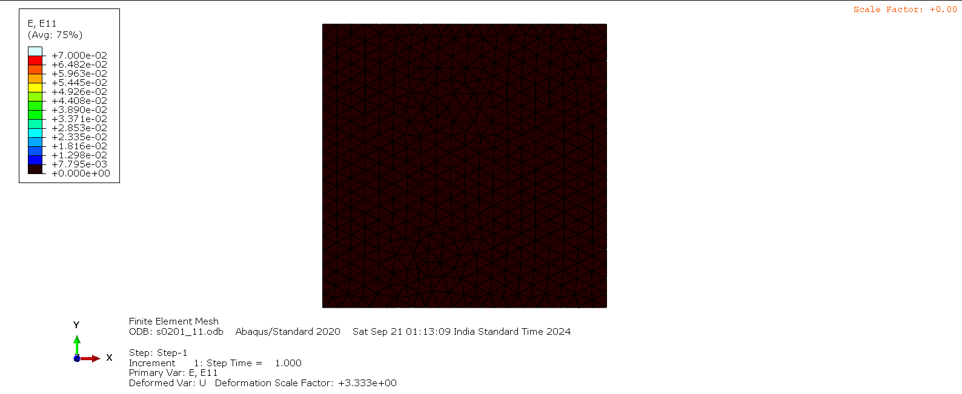
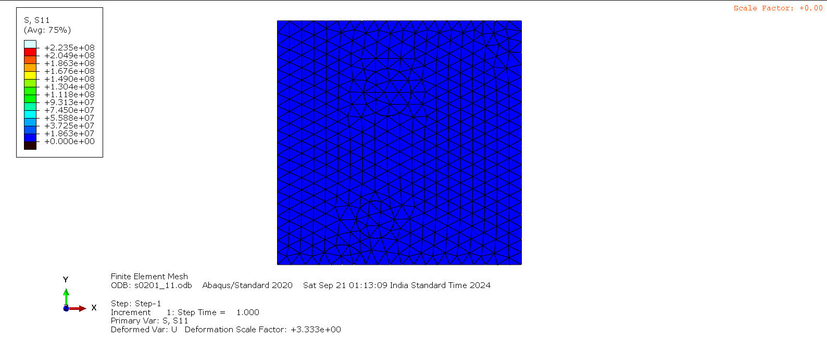
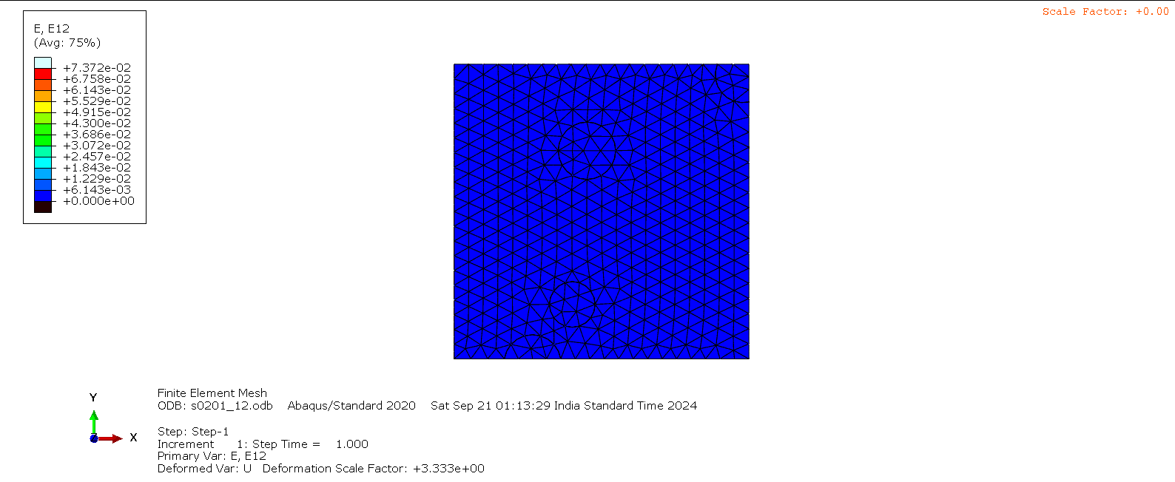

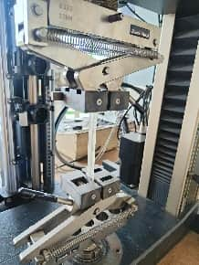
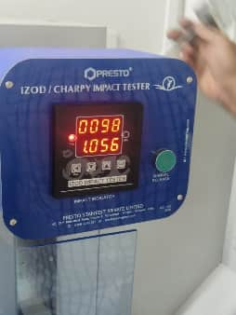
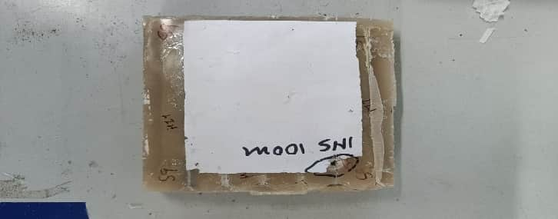
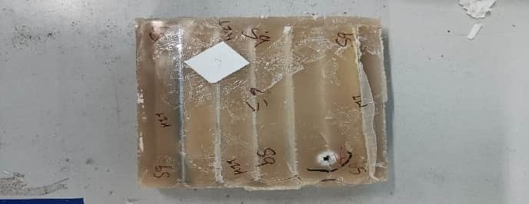
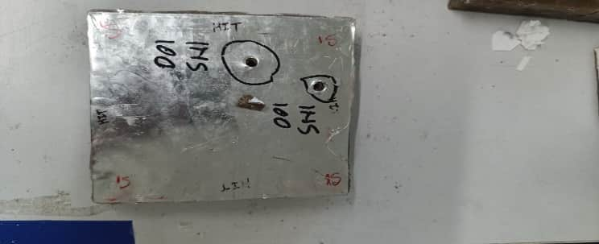
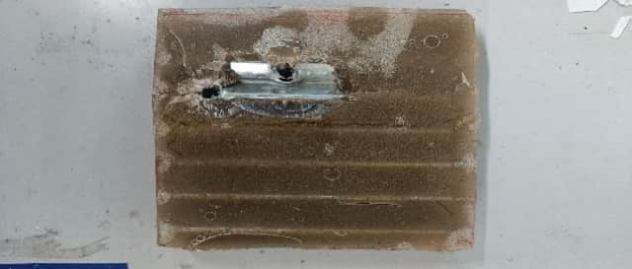
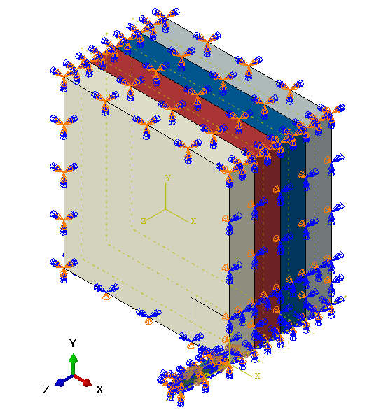
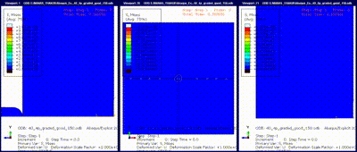
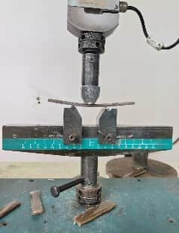
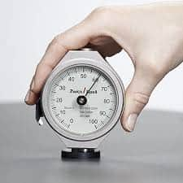
Methodology
Experimental Properties and Impact studies
0.3 to 1 mm size and 0.2 to 0.7 W_{i}
Effective Properties Extraction and Simulation Studies
0.3 to 1 mm size and 0.2 to 0.6 V_{i}
Refinement
V_{i}=0.2 Size=0.1mm
V_{i}=0.3 Size=0.2mm
V_{i}=0.5 Size=0.9mm
V_{i}=0.6 Size=1mm
Experimental-1
Experimental-2
Refined Specimens and Structures
Battery Of Tests
(Uniform Distribution of sand)
Experimental Bullet Impact Tests
Representative Volume Element
Disp BCs
S₁₁
E₁₁
E₁₂
S₁₂
Effective Properties E, v, G (Quasi-Isotropic)
Simulation Impact Studies
Front Face Back Face
Tensile Test
I-Zod Impact Test
Front Face Back Face
Axy Sym BCs
Projectile Impact on
Configurations
0.6 vi 1 mm | 0.6 vi 0.6 mm | 0.4 vi 0.425 mm | 0.4 vi 0.3 mm | 0.4 vi 0.3 mm
Output Studies
Flexural Test
Shore D Hardness Test

Slide 3
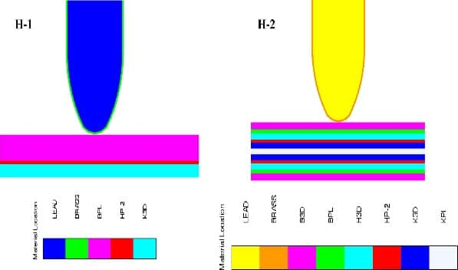
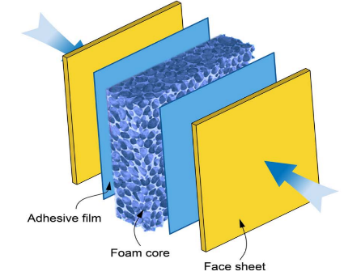
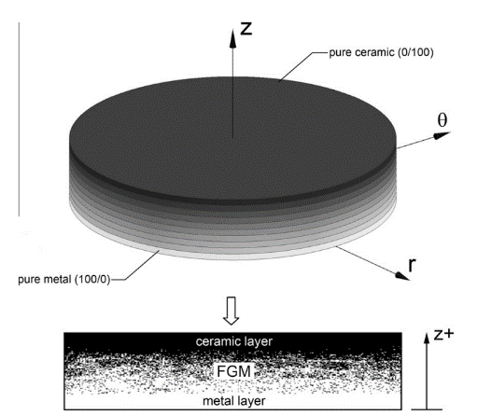
Motivation
Fiber-reinforced Polymers (FRPs)
Energy-Absorbing Structures
Functionally Graded Materials (FGMs)
https://doi.org/10.1016/j.compositesa.2016.12.007
https://doi.org/10.1016/j.compstruct.2010.07.008
Superior Protection while maintaining a lightweight profile.
Dissipation of K.E. over a larger area incorporating effective stacking sequence.
Tailor ability by virtue of constituent elements (Fibre, matrix, etc)
Multi-hit capability and Ability to integrate with ceramics with maintaining S-W ratio
CMFs provide high energy absorption per unit area with good thermal and acoustic insulation.
Corrugated sheets have high bending stiffness and are easily integrable.
Origami and honeycomb structures provide tuneable properties via geometric design with a high S-W ratio.
Novel class of material providing directional gradients in Material Properties.
Provides improvised shock-impedance characteristics required in different layers combined.
Reduced delamination and improvised multi-hit capability thereby mitigating localized stresses.

Slide 4
Layered Systems Issues
Bullet
(Kinetic Energy)
Structure
Denser, Stiffer and brittle region for Initial Impact resistance (Tip Deterioration)
Transferred Energy Absorption and K.E. dissipation
Cushioning effect and prevents backlash
Fiber Reinforced Polymers
Aluminum Backing
Ceramics, RHA Sheets, etc.
CMF, Origami Structures, Corrugations, etc.
Major Issues (FRPs)
Delamination, Matrix Cracking, Fiber Failure
Moisture Sensitive e.g. aramid fibers
Complexity in Manufacturing
Cost
Major Issues
Limited-Multi hit Capacity
Requires Strong Backing
Heavier and Cost-Ineffective
Major Issues
Manufacturing Complexity
Low Multi-Hit (deformed cells)
Density vs Energy Absorption

Slide 5
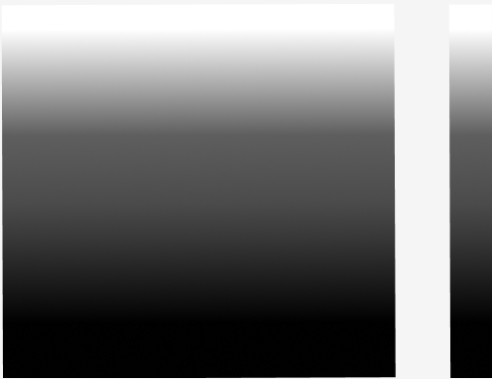
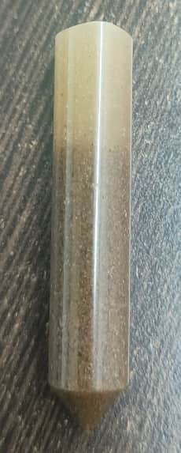
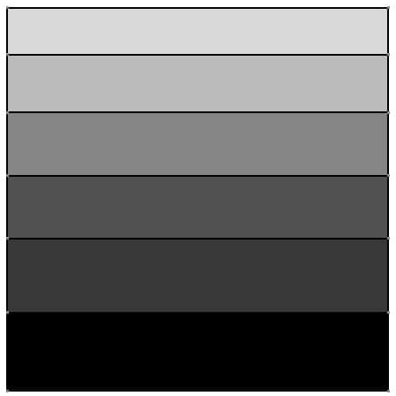
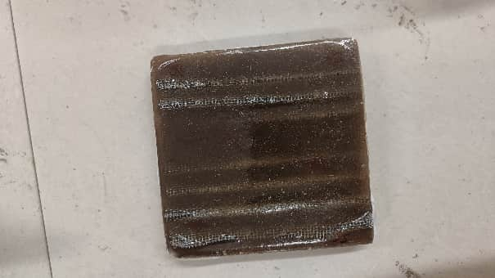

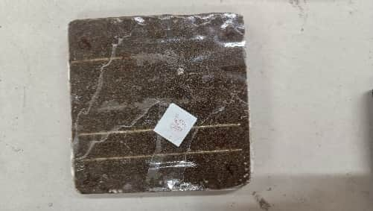
Conceptualization
PMSCs
Corrugated Fine Mesh
Barely Dense or Neat Matrix Region Providing Cushioning Effect(Preventing Backlash)
Less Dense Region Providing Backing to Absorb Residual Energy
Densely Graded Layer Providing Initial Impact Absorption and Abrasive Bullet Tip Deterioration (Harder + Abrasive Wear)
Projectile
Sand Inclusions
PMSCs with corrugated sheets
Corrugated GI/Al Sheets
Major Advantages
Sand particles increased the surface area resulting in better bonding
The abrasive nature of sand provides initial tip deterioration
Tailorable directional properties by varying particle size and fraction
Corrugated sheets act as stiff barriers or energy-absorbent mesh sheets at the end provide energy transfer to a larger area
Comparatively low cost, lightweight (Ceramics and metals), and manufacturing suitable structures.

Slide 6
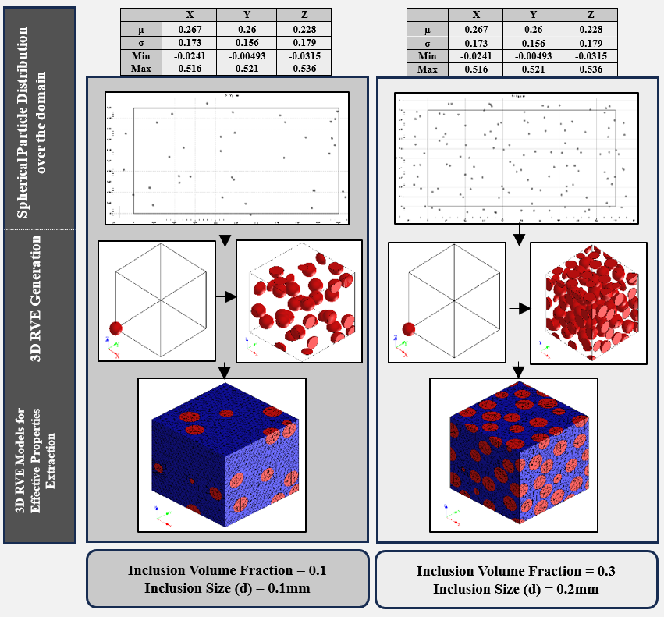
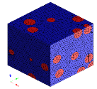
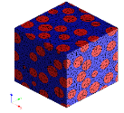
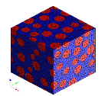
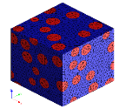
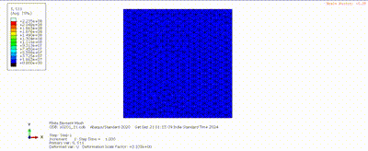
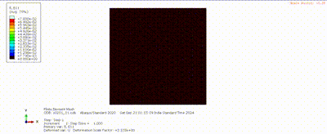
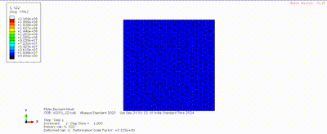
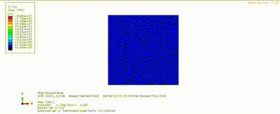

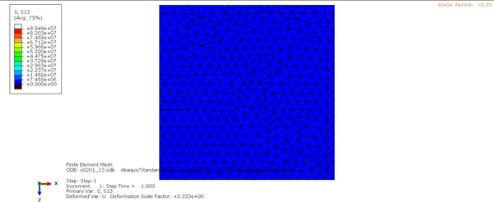
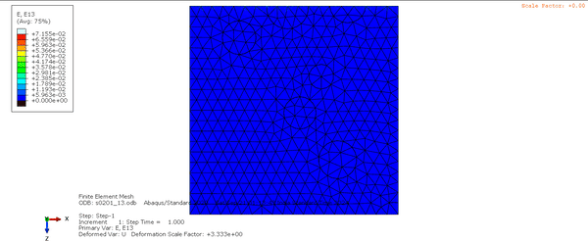
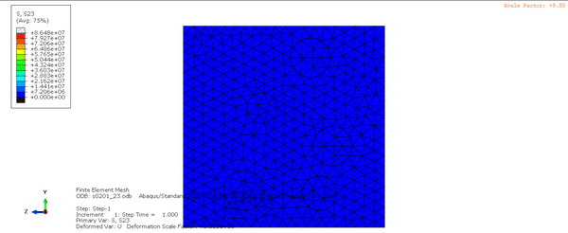

Effective Properties Extraction
RVE Modelling
BCs For Effective Properties Extraction
Typical Finalized Models of RVE
Imposed BCs to Evaluate Stresses and Strains in Respected Directions and Planes
S₁₁
S₁₂
E₁₁
E₁₂
S₂₂
S₁₃
E₂₂
E₁₃
S₃₃
S₂₃
E₃₃
E₂₃

Slide 7
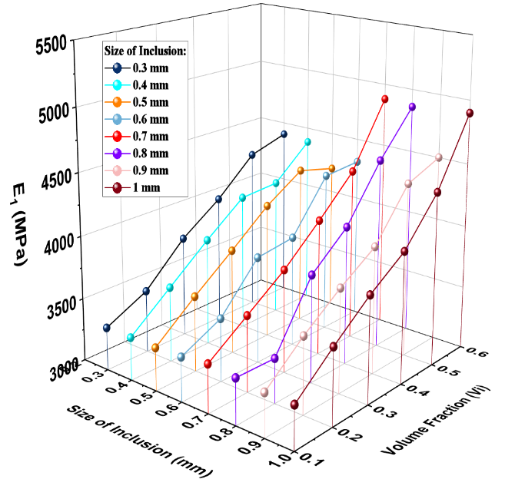
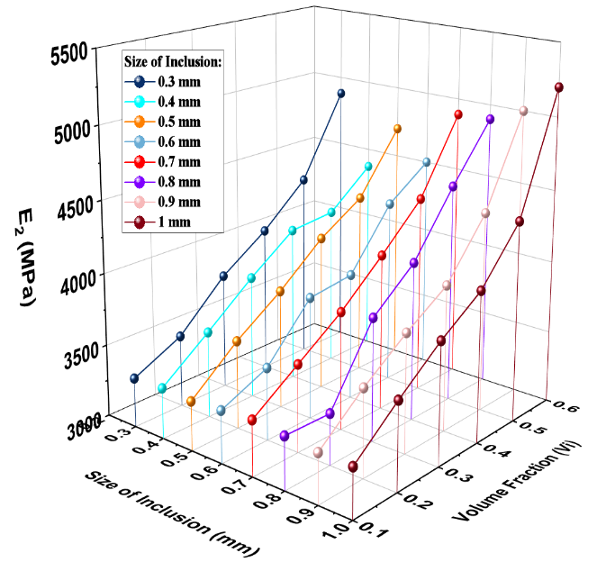
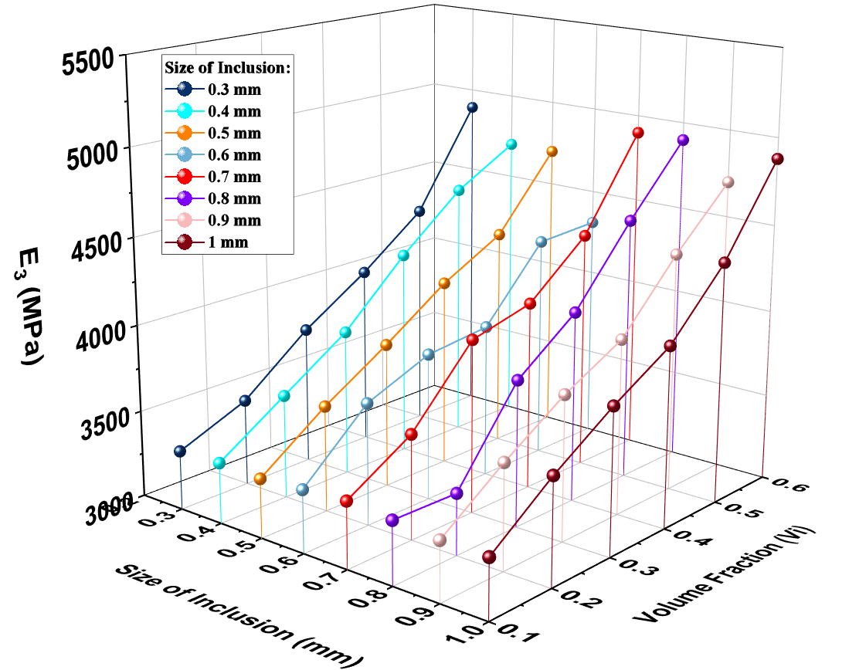
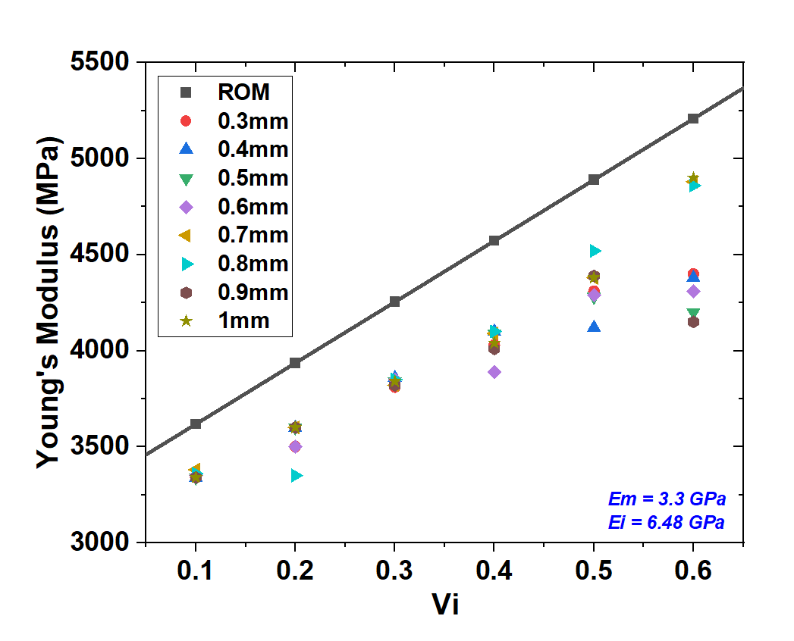
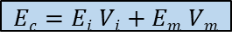
Effective Properties (E)
Observations and Conclusions
Young’s Modulus Increased as an increase in Size(d) and Volume fraction of Inclusions (V_{i})
Increasing Volume fraction reduced matrix dominant property variations
The quasi-isotropic properties as observed up to 0.6 Vi beyond which the material loses 3D isotropy which can be attributed to [14] Max Random Dense Packing C_{DR}=0.64 for Spherical Inclusions
Homogenous Isotropic Properties of Constituent Elements
Properties | LY556 (Epoxy) and HY951/917
Curing | 4 hours 80ºC post-cure 8 hours 140ºC
Viscosity | 10000-12000 mPa s
Shelf Life | 1.8 years
Modulus of Elasticity | 3100 – 3300 MPa
Density | 1.15 - 1.20 g/cm^3
Properties | Loose gravel high silica
Modulus of Elasticity (GPa) (Max) | 6.48 GPa
Poisson ratio | 0.2 – 0.35
Density g/cm³ | 1.2 – 1.52
$$Ec=Ei Vi+Em Vm$$
Epoxy and Hardener cured properties [12]
Sand Properties [13]

Slide 8
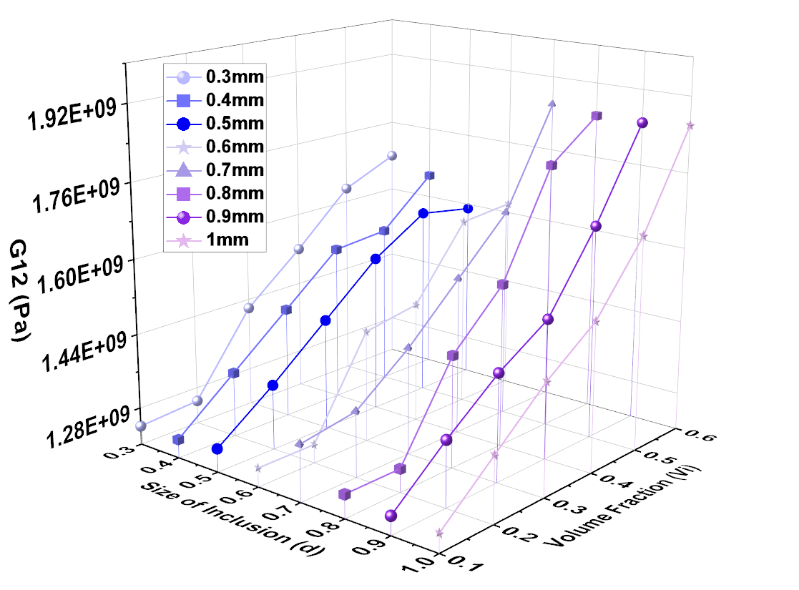
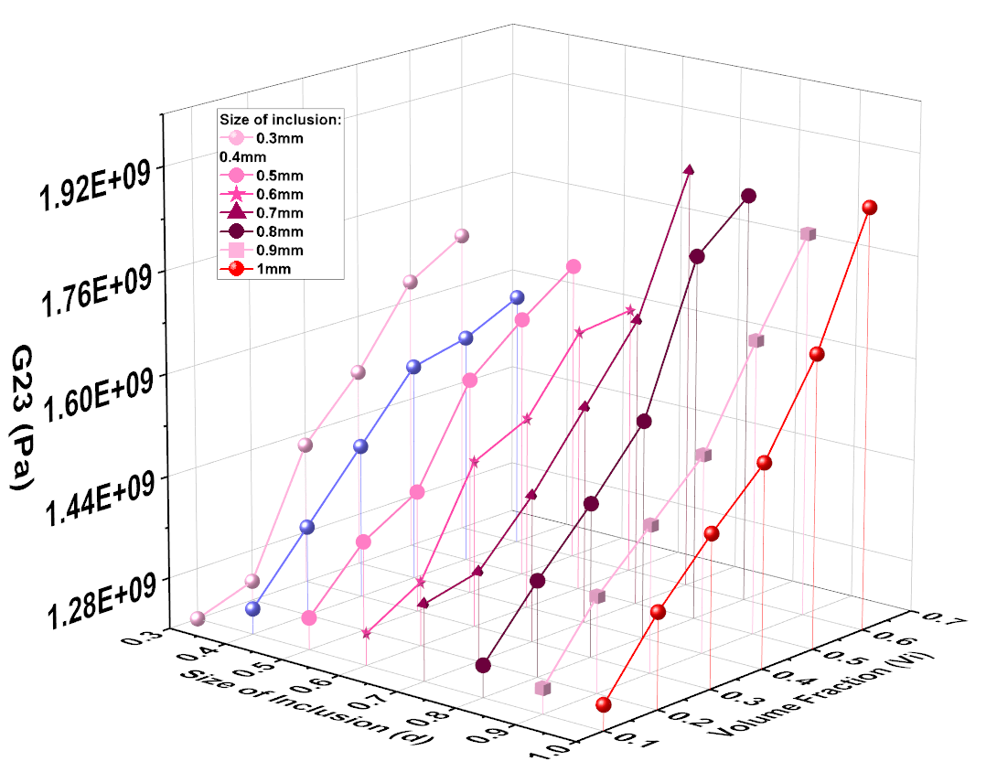
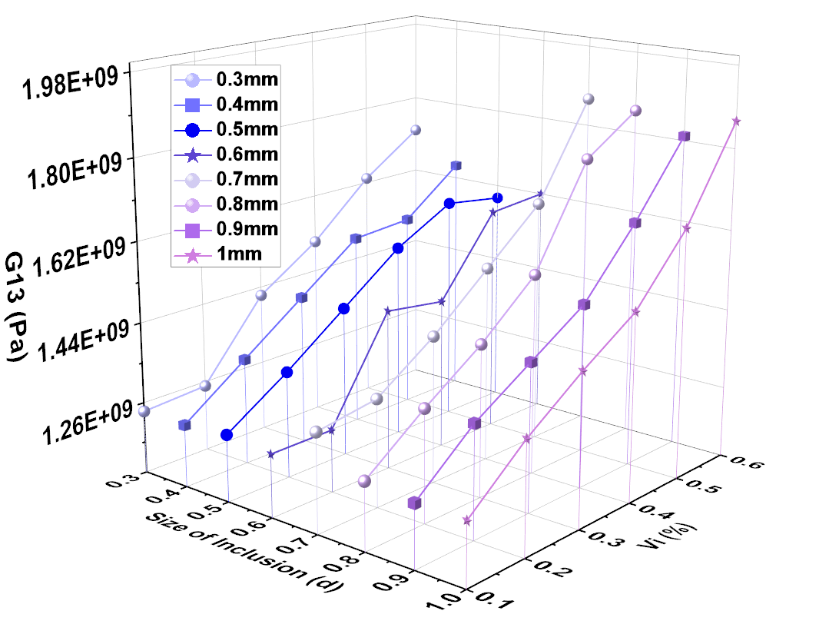
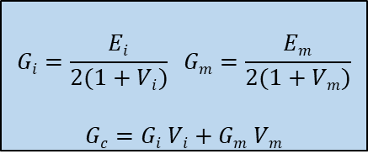
Effective Properties (G)
Observations and Conclusions
Shear Modulus Increased as an increase in Size(d) and Volume fraction of Inclusions (V_{i})
Larger inclusions provide better resistance to shear deformation.
The matrix ability to undergo shear is thereby limited resulting in increase shear modulus.
Homogenous Isotropic Properties of Constituent Elements
$$Gi=\frac{Ei}{2(1+Vi)} Gm=\frac{Em}{2(1+Vm)}$$
$$Gc=Gi Vi+Gm Vm$$
Properties | LY556 (Epoxy) and HY951/917
Curing | 4 hours 80ºC post-cure 8 hours 140ºC
Viscosity | 10000-12000 mPa s
Shelf Life | 1.8 years
Modulus of Elasticity | 3100 – 3300 MPa
Density | 1.15 - 1.20 g/cm^3
Properties | Loose gravel high silica
Modulus of Elasticity (GPa) (Max) | 6.48 GPa
Poisson ratio | 0.2 – 0.35
Density g/cm³ | 1.2 – 1.52
Epoxy and Hardener cured properties [12]
Sand Properties [13]

Slide 9
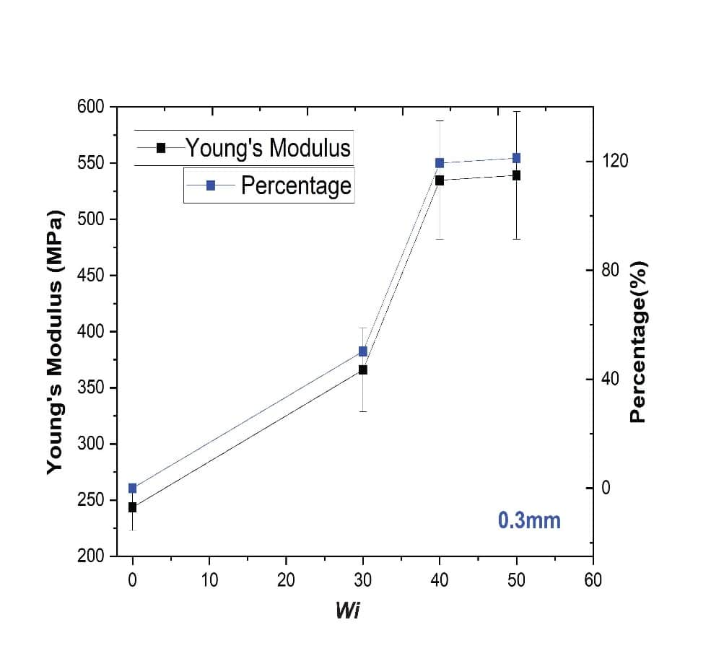
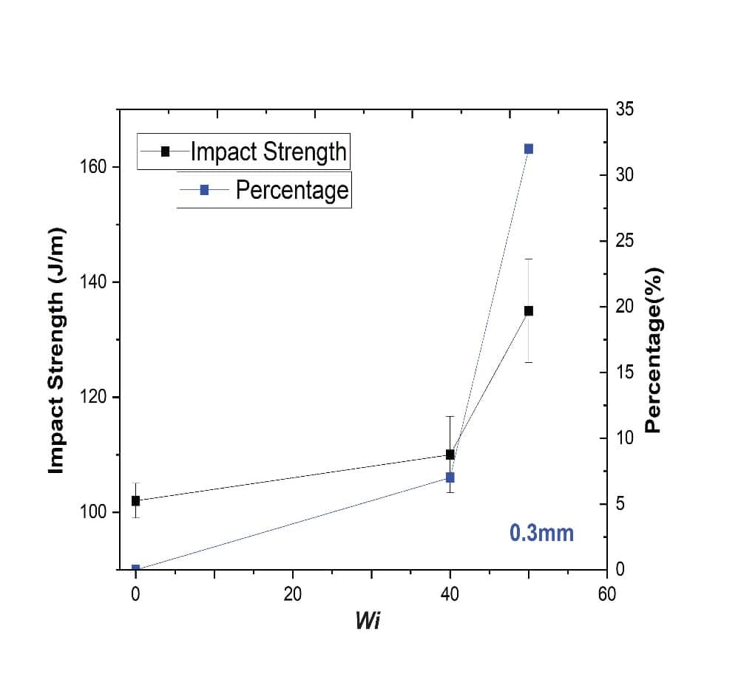
Results and Findings
EH150 and ER099 Tensile and Impact Test Results
Drawbacks/ Observations
Settling of sand
Insufficient bonding
Increased Shrinking
Increased Trapped air
Mechanical strength affected by post-curing.
30% sand – 360MPa (46% increase)
40% sand – 545MPa (120% increase)
50% sand – 550MPa (125% increase)
40% sand – 110 J/m (7% increase)
50% sand – 135 J/m (32% increase)

Slide 10
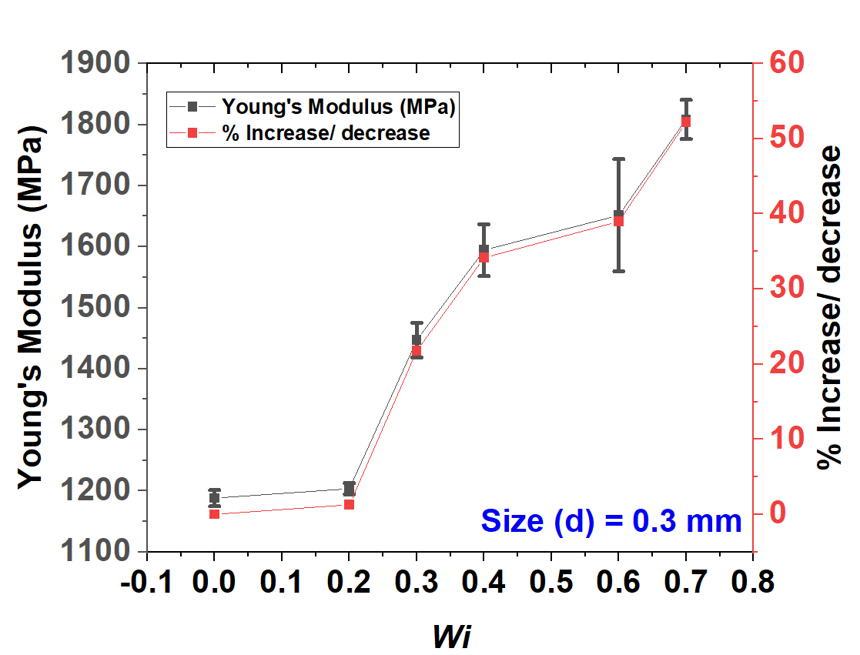
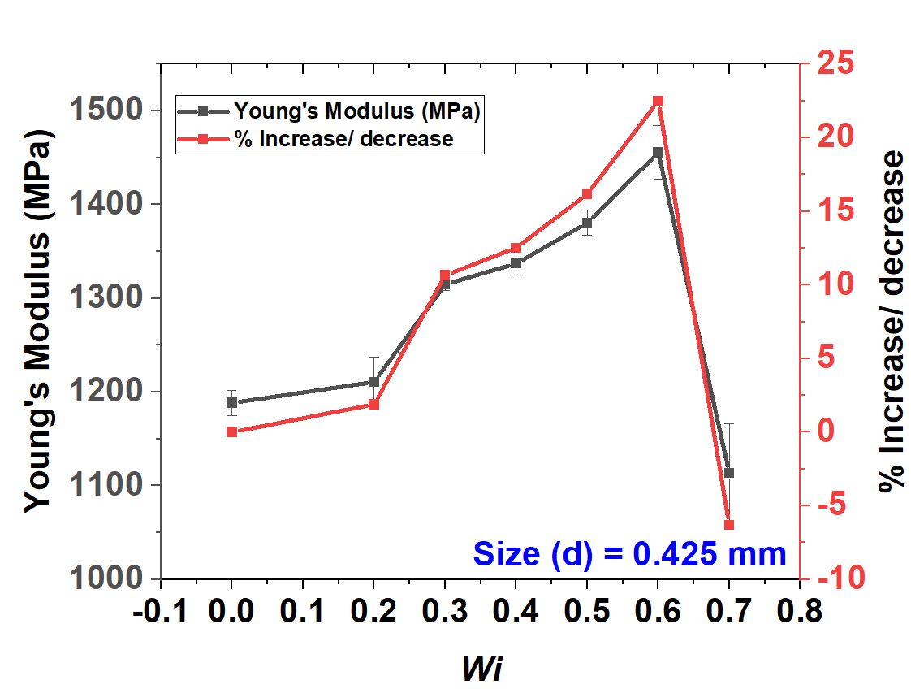


Results and Findings
Tensile Test Results (LY556 and HY951)- ASTM D638
Outcomes
1. Higher Modulus than previous grade Neat Epoxy.
2. 0.3 mm 70% content 1808.67 MPa Modulus was observed with 52.2% increase than neat epoxy.
3. 0.425 mm 60% content 1455.5 MPa was observed with 22.48% increase than neat epoxy.
4. 0.425 mm 70% a dip in Modulus was observed due to higher sand content occupied in less space causing weak matrix zones [10-11].
5. 0.6 mm 70% content 3224.75 MPa Modulus was observed with 58.02% increase than neat epoxy.

Slide 11




Results and Findings
Shore-D Hardness Test (LY556 and HY951) – ASTM D2240-15
Outcomes
1. 0.3mm 70% content 82.86 SDH with 13.87% increase than Neat Epoxy.
2. 0.425mm 70% content 88.7 SDH with 22.15% increase than Neat Epoxy.
3. 0.6mm 70% content 92.63 SDH with 27.30% increase than Neat Epoxy.
4. Increase in size and percentage content of sand in Matrix markedly influenced the Hardness of PMSCs [10].

Slide 12




Results and Findings
I-Zod Impact Test (LY556 and HY951) – ASTM D256-23
Outcomes
1. 0.3mm 70% Impact Strength of 240 J/m was observed which was highest among all the configurations.
2. 0.425mm 70% Impact Strength of 77.1 J/m was observed.
3. 0.6mm 70% Impact Strength of 146.6 J/m was observed.

Slide 13






Microstructural Analysis
a)
Agglomeration
0.425mm, 20%
b)
0.425mm, 30%
Observations :
The refined manufacturing process enabled a more uniform sand distribution up to a certain limit
Fewer agglomerations in small grain sizes and lower weight fractions a),b).
Larger Particles did not increase agglomerations although higher percentages increased agglomerations d).
Voids were lower owing to minor inconsistency in filling or dispersion c).
Denser sand regions and weak matrix regions are observed when increased percentage of sand.
Agglomeration
Sand Particles
Voids
500 µm
500 µm
0.425mm, 40%
c)
d)
0.425mm, 50%
Sand Particles
Voids
Agglomeration
Sand Particles
Voids
Agglomeration
500 µm
500 µm
e)
0.6mm, 40%
0.6mm, 60%
f)
Sand Particles
Denser Regions
Sand Particles
Denser Regions
Crack
Weaker Matrix Regions
Preliminary Impact Test
(Backup slides)
500 µm
500 µm

Slide 14
Typical Ballistic Structure Design Criteria
F
LP – Low Penetration
HP – High Penetration
HV – High Volume
LV – Low Volume
HF – High Force
LF – Low Volume
Not Desired
Not Desired
Not Desired
More Expensive/ Optimal
HF - LP
HF - HP
LV - HF
LV, LF ,LP
Not Desired
Less Expensive/ Less Optimal
Human/ Object Threshold
HV - HF
HV, HF , HP
V – Volume
F – Back-face Force
DOP – Depth of Penetration
LF - LP
LF - HP
Not Desired Structures
LV - LF
Towards Tradeoff
Optimality:
1. Cost Low
2. DOP Low
3. Force low
4. Mass low
5. Volume low
HV - LF
DOP
Most Optimum (Unrealistic)
Human/
Object Threshold
LV - LP
LV - HP
Optimum (realistic)
V
Not Desired
HV - LP
Not Desired
HV - HP

Slide 15




Impacted Structures (Simulation Studies)
BCs and Meshing
a) Overall Domain
b) Computational Model (Axi-Symmetric)
c) Meshed Model

Slide 16


Boundary Conditions and Meshing
C3D8R Element Type was used which is an 8-node linear hexahedral element with reduced integration and single integration point.
Hourglass control was activated which deals with elements distorting without strain energy (unphysical).
Mesh convergence analysis was performed with D.O.P. and Residual K.E. as a decision parameter.
Number of Elements were varied across Thickness of the Impacted zone from 8 to 80 elements. 32 elements across thickness were chosen to make a tradeoff between accuracy and computational cost
a) Finalized Meshed Model with exploded view of finer mesh on area of impact
b) Mesh convergence analysis

Slide 17
K.E. Vs D.O.P. Studies (20mm)
2RGUE_20 showed 98%, 96%, 95% and 90% K.E. dissipation for respective imparted velocities beyond 100m/s.
2RGU_20 densified configuration showed ballistic limit of 150m/s with 98% K.E. dissipation showing its better ballistic threshold.
75% K.E. absorption in first 3 Layers was observed in 4RG_20 Structures.
4RG_20 showed similar performance as 4RA_20 with a slight variation in Ballistic Limit of 171m/s and 168 m/s.
The findings suggest the increased layers significantly increase the ballistic limit with variation in gradation.

Slide 18





Rebound Characterization
2RGU_20
2RG_20
2RGU_20
2RG_20

Slide 19





Rebound Characterization
4RG_20
4RA_20
4RG_20
4RA_20

Slide 20

K.E. Vs D.O.P. (40mm)
4RGUE showed 98%, 90% K.E. dissipation for 210m/s and 225m/s.
4RGU densified configuration showed ballistic limit of 250m/s with 97% and 90% K.E. dissipation at 250m/s and 275m/s showing its better ballistic threshold.
90% K.E. absorption in first 3 Layers was observed in 4RG_40 Structures.
4RG_40 showed similar performance as 4RA_40 with a slight variation in Ballistic Limit of 215m/s and 210 m/s.
The findings suggest the increased layers significantly increase the ballistic limit with variation in gradation.
4RA_40

Slide 21






Back face Signature Characterization
3RG_40
4RG_40
4RGU_40
4RGUE_40
4RA_40

Slide 22



S.E.A Optimization Approach
Optimization using Specific energy absorption approach [15]
Multi-Layered Configuration | Thickness(mm) | Areal Density of target (kg/m²) | SEA of target (J-m²/kg)
2RG_20 | 20 | 24.59 | 3.63
2RGU_20 | 20 | 25.19 | 3.64
2RGUE_20 | 20 | 24 | 3.31
4RG_20 | 20 | 24.75 | 4.09
4RA_20 | 20 | 24.92 | 4.04
$$ρs= \sum{ρi ∗ti}$$ $ρi$ = Density of $ith$layer material
$ti$= Thickness of $ith$ layer
SEA = $\frac{Ea}{ρs}$
$Ea$ = Total energy absorbed by the target
$ρs$ = Areal density of target
Multi-Layered Configuration | Thickness(mm) | Areal Density of target (kg/m²) | SEA of target (J-m²/kg)
3RG_40 | 40 | 49.23 | 3.28
4RG_40 | 40 | 49.51 | 3.37
4RGU_40 | 40 | 50.38 | 3.44
4RA_40 | 40 | 49.85 | 3.34
4RGUE_40 | 40 | 48 | 3.27

Slide 23
Conclusion:
Experimental tests of PMSCs showed enhancement in material properties.
Fewer agglomerations were seen for less size and weight fractions.
Void contents were reduced with refinement in the manufacturing process.
The simulation studies showed enhancement in effective properties with increased Vi and Size(d).
The increasing layers enhanced the ballistic limit with minimal variation in areal density.
The increasing layer showed enhanced rebound characteristics.
The alternate layers configuration showed the least blackface deformation.

Slide 24
Utilization of Hyperplastic material for enhanced cushioning effect
Future Scope
Enhancement in Ballistic Limit via Frontal Harder Layer
Deep Learning Practices to Predict Properties with Varied Constituents
Complex Geometry Fabrication of PMSCs

Slide 25
References
[1] Marx, J., Portanova, M. and Rabiei, A., 2020. Performance of composite metal foam armors against various threat sizes. Journal of Composites Science, 4(4), p.176.
[2] Wadley, H.N.G., Dharmasena, K.P., O'Masta, M.R. and Wetzel, J.J., 2013. Impact response of aluminum corrugated core sandwich panels. International Journal of Impact Engineering, 62, pp.114-128.
[3] Cui, T., Zhang, J., Li, K., Peng, J., Chen, H., Qin, Q. and Poh, L.H., 2022. Ballistic limit of sandwich plates with a metal foam core. Journal of Applied Mechanics, 89(2), p.021006.
[4] Gellert, E.P., Cimpoeru, S.J. and Woodward, R.L., 2000. A study of the effect of target thickness on the ballistic perforation of glass-fibre-reinforced plastic composites. International Journal of Impact Engineering, 24(5), pp.445-456.
[5] Reddy, P.R.S., Reddy, T.S., Mogulanna, K., Srikanth, I., Madhu, V. and Rao, K.V., 2017. Ballistic impact studies on carbon and E-glass fibre based hybrid composite laminates. Procedia engineering, 173, pp.293-298.
[6] Wambua, P., Ivens, J. and Verpoest, I., 2003. Natural fibres: can they replace glass in fibre reinforced plastics?. Composites science and technology, 63(9), pp.1259-1264.
[7] ] Zemani, K., May, A., Khatir, S., Gilson, L., Cuong-Le, T., Wahab, M.A. and Slamani, H., 2024. Numerical analysis of an experimental ballistic test of Al/SiC functionally graded materi als. Composite Structures, 333, p.117909.
[8] Etemadi, E., Khatibi, A.A. and Takaffoli, M., 2009. 3D finite element simulation of sandwich panels with a functionally graded core subjected to low velocity impact. Composite Struc-tures, 89(1), pp.28-34.
[9] Akbar, H.I., Surojo, E., Ariawan, D., Prabowo, A.R. and Imanullah, F., 2021. Fabrication of AA6061-sea sand composite and analysis of its properties. Heliyon, 7(8).
[10] Kumar, T.S., Joladarashi, S., Kulkarni, S.M. and Doddamani, S., 2024. Influence of sea sand reinforcement on the static and dynamic properties of functionally graded epoxy composites. Iranian Polymer Journal, pp.1-18.
[11] Shi, J., Chen, D. and Yu, Z., 2024. Novel epoxy resin-bonded sand system: Mechanical strength, deterioration resistance, and failure mechanism. Engineering Failure Analysis, 158, p.108020.
[12] https://www.farix.hu/pdf/1360669728.pdf
[13] Molina, O., Vilarrasa, V. and Zeidouni, M., 2017. Geologic carbon storage for shale gas recovery. Energy Procedia, 114, pp.5748-5760. [14] Murthy, V.C.A.D. and Santhanakrishnanan, S., 2020. Isogrid lattice structure for armouring applications. Procedia Manufacturing, 48, pp.e1-e11.
[15] Kapoor, S., Ray, S., Sahoo, J.P. and Joshi, Y.K., 2024. Optimization of multi-layered composites against ballistic impact: A mesoscale approach. Composite Structures, 338, p.118097.

Slide 26

Thankyou.

Slide 27

D.O.P Vs Time
4RGUE showed a critical velocity of 175m/s with full perforation of the Structure.
4RGU showed a ballistic limit of 225m/s showing rebound characteristics till 145m/s.
Graded 4R_40 Configuration showed Critical velocity of 225m/s with higher rebound.
4GA showed Ballistic Limit beyond Similar to 4RGU with 210m/s and 215m/s respectively.
The findings suggest the increased layers significantly increase the Rebound Characteristics and Alternate arrangement shows lower back face signature with variation in gradation.

Slide 28
D.O.P Vs Time
2RGUE_20 showed a critical velocity of 110m/s with full perforation of the Structure.
2RGU_20 showed a ballistic limit of 150m/s showing rebound characteristics till 145m/s.
Graded 2RG_20 Configuration showed Critical velocity of 145m/s with higher rebound characteristics till 135m/s.
4RG_20 showed Ballistic Limit beyond 160m/s with minor variation in 4RA_20 Structural Configuration
The findings suggest the increased layers significantly increase the Rebound Characteristics with variation in gradation.

Slide 29
Typical Ballistic Structure Design Criteria
Not Desired
Not Desired
Not Desired
HF - LP
HF - HP
Backface Force
Not Desired
LV - HF
Human Threshold
LF - LP
LF - HP
HV - HF
HV - LF
More-Expensive
Less-Expensive
Depth of Penetration
Human Threshold
Most optimum
(unrealistic)
LV - HP
HV - LF
LV - LP
Volume
Not Desired
HV - LP
HV - HP
Not Desired

Slide 30
Conferences and Proceedings
Previous Work Presented Titled “Deep Convolutional Neural Network for Predicting Elastic Properties of Random Distribution of Long Fibre Reinforced Composites” at “Asian Congress on Gas Turbines 2024”
Host: Indian Institute of Technology Kanpur, Aug 21-23, 2024. (Presented)
Abstract of the work has been submitted at “International Conference on Mechanics of Advanced Materials and Structures (ICMAMS)”
Host: Ramaiah Institute of Technology, Bengaluru, Karnataka, India, Dec 11-13, 2024. (Accepted)
Abstract of the work has been submitted at “1st International and 7th National Conference on Multidisciplinary Design, Analysis and Optimization (iNCMDAO 2024)”
Host: Indian Institute Of Science, Bengaluru (IISc-Bengaluru), Karnataka, India, Dec 16-18, 2024. (Accepted)
Abstract of the work has been submitted to “EnPoWER | TechConnect'24 | ResCon: Soch Vichar Achar | Research Poster Presentation Competition.”
Host: Indian Institute of Technology Bombay. (Accepted)

Slide 31









Literature Survey
Sandwich-Core Structures
FRPs and Stagged Structures
CMFs with RHA face sheet, ceramic plate, and Al backing, absorbed 70-83% of bullet K.E. and higher MER ratio [1].
hollow and AD-995 alumina-filled corrugated aluminum 6061T6 : Hollow-apex and Base – CV-530-590 m/s
Solid – CV - 650-675 m/s
Filled - 1300 m/s [2].
FEM model showed 46%, 13%, and 41% energy absorption for front and back CF prepreg, Honeycomb respt. [3]
GRP and Kevlar target similar responses with ballistic limits higher for more thickness and blunt projectiles [4].
A 50:50 RATIO OF Hybrid E-Glass and Carbon Fiber Composites showed 17% and 30% higher energy absorption than C100 and E 100 composites respt. [5]
This study compares natural fiber-reinforced polypropylene composites, finding hemp superior in impact properties, and coir with higher impact strength than jute and kenaf. [6]
Functionally Graded Materials (FGMs)
Sand reinforced Polymers
Al/SiC FGMs higher ballistic performance DOP = 8.44mm. The DTTO model for plastic behavior and the JC model for high strain rate studies are proving effective. [7]
low-velocity impact on FG core sandwich beams showed similar contact force history in symmetric and axisymmetric cases, with higher maximum contact force and lower strain than the homogeneous core. [8]
Electroless coating for sea sand composites enhanced wettability, increasing hardness by 30% and improving tensile strength with higher sand content. [9]
Sea sand showed void percentage and Shore D hardness with a higher fraction increase, and a 15.12% toughness increase at 30% for 2 bar pressure, 20.37% at 3 bar, and 7.91% at 4 bar pressure. [10]

Slide 32
Objective
1) To evaluate the effect of sand inclusion’s size, weight fraction, and matrix material on Polymer matrix Sand composite (PMSCs) structure properties.
2) To Conduct Experimental and Simulation analysis for effective stacking.

Slide 33
Materials
Material Properties the Johnson-Cook (JC) material the model used in the Computational model derived from [14]
Element Deletion parameters given to PMSCs Extracted from Uni-axial tensile test.
Parameter | Description | AISI 4340
D1 | Failure Parameter | 0.05
D2 | Failure Parameter | 3.44
D3 | Failure Parameter | -2.12
D4 | Failure Parameter | 0.002
D5 | Failure Parameter | 0.61
Þ (kg^m-3) | Density | 7830
E (GPa) | Young's Modulus | 205
A (MPa) | Yield Stress | 792
B (MPa) | Hardening Constant | 510
n | Hardening Exponent | 0.26
c | Strain Rate Constant | 0.014
m | Temperature Softening Exponent | 1.03
Tm (K) | Melting Temperature | 1519.9
ϵ (s^-1) | Reference Strain Rate | 1
Tr (K) | Reference Temperature | 22
wi | Size | E(Pa) | µ | Global Density rho | Yield Stress (Pa) | Plastic Strain | Stress Triaxiality | Displacement at Failure
0.2 | 0.425 | 1.21E+09 | 0.35 | 1216.446 | 2.01E+07 | 0.019 | 0.33 | 2.30E-03
 |  |  |  |  | 2.15E+07 | 0.02
0.3 | 0.425 | 1.31E+09 | 0.35 | 1224.839 | 2.59E+07 | 0.029 | 0.33 | 3.40E-03
 |  |  |  |  | 2.67E+07 | 0.03
0.4 | 0.425 | 1.33E+09 | 0.35 | 1233.349 | 3.16E+07 | 0.0255 | 0.33 | 3.20E-03
 |  |  |  |  | 3.29E+07 | 0.0275
0.5 | 0.425 | 1.38E+09 | 0.35 | 1241.978 | 3.67E+07 | 0.03 | 0.33 | 3.50E-03
 |  |  |  |  | 3.77E+07 | 0.031
0.6 | 0.425 | 1.49E+09 | 0.35 | 1250.729 | 4.05E+07 | 0.032 | 0.33 | 3.80E-03
 |  |  |  |  | 4.15E+07 | 0.034
0.7 | 0.425 | 1.11E+09 | 0.35 | 1259.604 | 1.27E+07 | 0.0139 | 0.33 | 1.60E-03
 |  |  |  |  | 1.29E+07 | 0.014
0.2 | 0.3 | 1.20E+09 | 0.35 | 1216.446 | 3.15E+07 | 0.03235 | 0.33 | 3.55E-03
 |  |  |  |  | 3.27E+07 | 0.0327
0.3 | 0.3 | 1.45E+09 | 0.35 | 1224.839 | 3.65E+07 | 0.032 | 0.33 | 3.55E-03
 |  |  |  |  | 3.71E+07 | 0.037
0.4 | 0.3 | 1.59E+09 | 0.35 | 1233.349 | 3.69E+07 | 0.029 | 0.33 | 3.40E-03
 |  |  |  |  | 3.79E+07 | 0.03
0.6 | 0.3 | 1.65E+09 | 0.35 | 1250.729 | 3.57E+07 | 0.025 | 0.33 | 2.94E-03
 |  |  |  |  | 3.67E+07 | 0.0259
0.7 | 0.3 | 1.81E+09 | 0.35 | 1259.604 | 3.91E+07 | 0.0257 | 0.33 | 3.45E-03
 |  |  |  |  | 4.10E+07 | 0.0259
Neat |  | 1.19E+09 | 0.35 | 1200 | 3.12E+07 | 0.029 | 0.33 | 3.40E-03
 |  |  |  |  | 3.22E+07 | 0.03

Slide 34


Preliminary Projectile Impact Studies
Projectile Impact Results
Assertions:
Both samples were subjected to ballistic testing using an INSAS rifle from a distance of 100m.
Sample LY15_05 showed a larger bullet impact area compared to sample ER20_05.
Corrugated Mesh Limited Fragmentation upon Multi-hit.
LY20_05 had more visible cracks, suggesting it absorbed more impact energy due to crack propagation.
ER, EH grade
t=20mm
d=0.6mm
wi=0.5,0.3
1 GI Sheets, 1Mesh
Front Face ER20-05 Back Face ER20-05
LY, HY grade
t=15 mm
d=0.6mm
wi=0.5,0.3
1GI Sheet, 1 Mesh
Front Face LY15-05 Back Face LY15-05

Slide 35


Preliminary Projectile Impact Studies
Projectile Impact Results
Assertions:
Both samples were subjected to ballistic testing using an AK-47 rifle from a distance of 50m.
Corrugated GI Sheets at the front provided stiffened layer with higher bending stiffness thereby distributing stresses over a larger area.
Higher stiffness of LY556 epoxy and better bonding contributed to the larger impact area in LY25_06.
ER, EH grade
t=20mm
d=0.6mm
wi=0.5
1 GI Sheets, 1Mesh
Front Face ER20-03 Back Face ER20-03
LY, HY grade
t=20 mm
d=0.6mm
wi=0.3
1GI Sheet, 1 Mesh
Front Face LY20-06 Back Face LY20-06

Slide 36


Preliminary Projectile Impact Studies
Projectile Impact Results
Assertions:
Sample in the first figure, Ballistic testing using an INSAS rifle at 50m. The sample showed incomplete penetration up to two shots fired and further delamination due to increased layering.
The sample in the second figure was tested with an SIG rifle at 50m. The sample showed bullet’s trajectory deflection resulting due to alternate corrugations.
An increased damage along the thickness suggests the dominant effect of layering in structure with bullet deuteriation as a major contributor.
LY, HY grade
t=80 mm
d=0.425mm
3 GI corrugated
1 Mesh corrugated
Front Face LY80-04_2 Back Face LY80_04_2
LY, HY grade
t=80 mm
d=0.425mm
2 GI corrugated
2 Mesh corrugated.
Front Face LY80-04_1 Side Face LY80_04_1

Slide 37










Manufacturing Procedure-2
Sample Preparation
+
+
Epoxy LY556 and Hardener HY951 were chosen
[Miturska]
They were weighed and mixed initially hand stirred in 2:1 ratio for 2-3 minutes.
The mixture was further mixed using overhead stirrer at a speed of 800rpm for 7-8minutes. [Miturska]
Air Dry
for 24hrs
Tensile Samples
The finished samples were polished on a BAINPOL METCO machine at 120 rpm using 220-grit paper.
Samples had been initially finished with 120-grit sandpaper
The specimens were removed from the molds and post-cured in a hot-air oven at 120°C for 12 hours.
The molds were stuck using similar process in phase 1 and mixture was poured

Slide 38













Manufacturing Procedure-2
Experiment- 2
Sand Pre-Processing
150 µm
300 µm
Sun Dry
+Iso Propyl Wash
Dried Sand
Sand
425 µm
Construction Sand was obtained from the same area
The sand was dried in a blast furnace at 140°C for 6 hours to remove residual moisture.
Sand was milled using PULVERISETTE 7, to get particle size < 0.1 μm for precise grain distribution.
Sieving for 15 min using Electrical Sieve Shaker.
600 µm
Mold Preparation
Molds
CAD model of the
Tensile, impact and flexural sample
The molds were 3D-printed with TPU (90% infill) using a 0.4 mm nozzle at 200°C, 60°C bed temperature, and 50 mm/s speed.
Impact Sample Mold
Tensile Sample Mold
Flexural Sample Mold

Slide 39













Manufacturing Procedure-1
Experiment-1
Sand Pre-Processing
Mold Preparation
Air Drying
For 24 hrs
150 µm Sand
Construction Sand was obtained from a nearby area.
Sieving for 15 min using Electrical Sieve Shaker.
CAD model of the
tensile sample
Laser cutting of Silicone rubber sheet
300 µm Sand
Sample Preparation
Add Sand
into mixture
+
Releasing Agent PVA was applied on the OHP sheet
The mold was stuck onto the OHP sheet after the PVA layer had dried
Trans ER099 Epoxy+EH150 Hardener mixture is weighed and hand stirred for 3-5 min
Magnetic stirring was performed with a bead 35x7 mm at 80% of max speed for 7-10 minutes
Mixture was poured into mold and was left for curing for 24 hrs. Sand paper finishing was done

Slide 40
Contents
Motivation
Literature Survey
Contents
Issues / Gaps
Novelty
Objectives
Methodology
Results and Discussion

Slide 41

K.E. Vs Time
In 3RG Structure the K.E. progressively reaches Zero till approx. 200m/s.
The 4RGUE configuration performed the least while considering K.E. absorption due to relatively less resistance offered to bullet penetration.
The increased layer trend continues as in 20mm configurations showing enhanced K.E. absorption.
4RGU_40 structure performed the best sowing max K.E. absorption till 225m/s.
The graded structure 4RG_40 showed similar characteristics as of 4RA_40 with negligible difference in K.E. absorption.

Slide 42
K.E. Vs Time
2RGU_20 showed the Highest K.E. Absorption among other Configurations
2RGUE_20 showed the least K.E. Absorption due to relatively less stiff neat matrix structure.
The K.E. absorption Increased with an increase in Number of Layers i.e. from 2 to 4.
Compared to 2RG_20 4RG_20 showed Higher K.E. Due to higher impedance mismatches in interfaces with increased layers.
The alternate configuration i.e. 4RA_20 showed minimal variation in K.E. absorption than 4RG_20.

Slide 43
Boundary Conditions and Meshing
a) Overall Domain
b) Computational Model (Axi-Symmetric)
c) Meshed Model
• Symmetricity-X B.C.s – Face OA ,where U1=0
• Symmetricity-Y B.C.s – Face OB, where U2=0
• ENCASTER on the other faces, where U1=U2=U3=0

Slide 44
















Impacted Structures and Geometry
20mm thickness Impacted Structures
Geometry
Less Dense Layer
Overall Less Dense Material
Less Dense Layer
Densified Hard Layer
Less Dense Layer
Less Dense Layer
Densified Hard Layer
Overall Dense Structure
Densified Hard Layer
Densified Hard Layer
2RG_20
2RGU_20
2RGUE_20
4RG_20
4RA_20
Densified Hard Layer
Densified Hard Layer
Less Dense Layer
Hard Layer
Hard Layer
Less Dense Layer
Less Dense Layer
Less Dense Layer
Densified Hard Layer
Less Dense Layer
3RG_40
4RG_40
4RGU_40
4RGUE_40
4RA_40
40mm thickness Impacted Structures

Slide 45
Impacted Structures and Geometry
20mm thickness Impacted Structures
Geometry
Less Dense Layer
Overall Less Dense Material
Less Dense Layer
Densified Hard Layer
Less Dense Layer
Less Dense Layer
Densified Hard Layer
Overall Dense Structure
Densified Hard Layer
Densified Hard Layer
2RG_20
2RGU_20
2RGUE_20
4RG_20
4RA_20
Densified Hard Layer
Densified Hard Layer
Less Dense Layer
Hard Layer
Hard Layer
Less Dense Layer
Less Dense Layer
Less Dense Layer
Densified Hard Layer
Less Dense Layer
3RG_40
4RG_40
4RGU_40
4RGUE_40
4RA_40
40mm thickness Impacted Structures

